Slide 1

Intrusion detection system
USING DEEP LEARNING….

Slide 2
PROBLEM STATEMENT
Problem occurring due to extended use internet.
Many challenges arise since malicious attacks are continually changing.
Sometimes software like anti-virus, firewalls etc. lack the ability to detect unknown attacks.

Slide 3
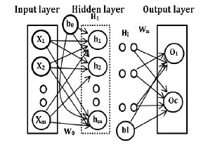
SCOPE
An IDS is a proactive intrusion detection tool used to detect and classify intrusions, attacks, or violations of the security policies automatically at network-level and host-level infrastructure in a timely manner.
Intrusion Detection Systems are very important software or hardware security tools to remove threats that would otherwise occur when carrying information, to prevent unauthorized access or abuse, and to report attacks to those responsible for security.

Slide 4
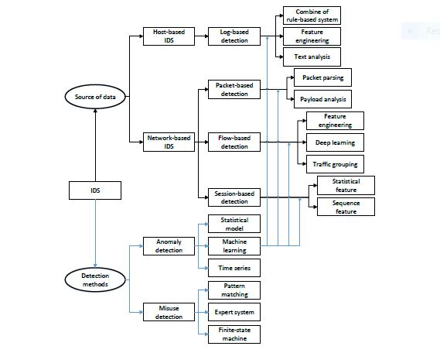
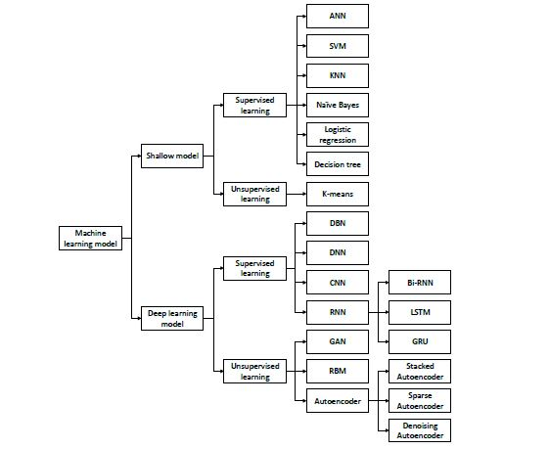
Working of IDS
Algorithms of IDS

